Slide 1
ReAlive
Team name: Exception Handlers
Team:
Rajat Keshri
Samanvya Tripathi
Aakash Mahesha

Slide 2
Purpose
To reinvent the way we experience photos from the past. Today we have powerful phones that can capture a Live Photo (a short recording of the scene) which helps in better recollection of the surrounding sounds and atmosphere as a whole. For a person who wasn’t present at the time the photo being taken, it’s slightly “less stimulating” to look at somebody else’s photos.
Our project helps bring these photos to life, by adding an audio element and animating the still image. This is our small attempt to expand the sensory horizon of digital applications and different experiences that we can create for various communities.

Slide 3
Problems our project can address
Giving life to historic events, via creating sound maps for pictures from the medieval times.
Giving a medium for the visually impaired to sense photographs via sound.
Creating short animated gifs for more engaging digital media

Slide 4
What we ACTUALLY did?
Identify the objects in the photo and create a realistic sound map, based on scene description.

Slide 5
HOW EXACTLY?
By applying a unique way of inferring the contents of the image.
Image Captioning + Depth Imaging!!
Yes. By generating an caption for the image, we used it for identifying the potential entity (physical and non - physical) and action words, that could be possibly be generating sounds when the image was taken.

Slide 6







Flow and Architecture
Speech Mapping Database
Object Detection and Context relation
Text Generated
ImageToCaption
(CNN + RNN LSTM)
Keyword tokenizer
Text SPeech Mapping
Image
Depth Imaging (distance identification CNN and OpenCV)
Distances
Intensity Mapping and Amplitude prediction
Sound Synthesizer (Based on cosine similarity, MFCC and Intensity Mapping)
Video
Image + sound overlayer

Slide 7
Flow and Architecture – Image to Caption
Image caption pair encoded to tight space vector
CNN Encoder
RNN LSTM
Images
Keyword Tokenization
Text Generated
Captions
Caption encoding
Keyword Generation

Slide 8
Flow and Architecture – Speech Mapping and Synthesizer
Audio
Mapping
Extracting relevant audio samples
Audio Synthesizer using MFCCs and cosine rule
Intensity Sorting
Keyword Tokens
Image Depth Mapping
Intensity/ Amplitude Mapping
Audio Generated

Slide 9
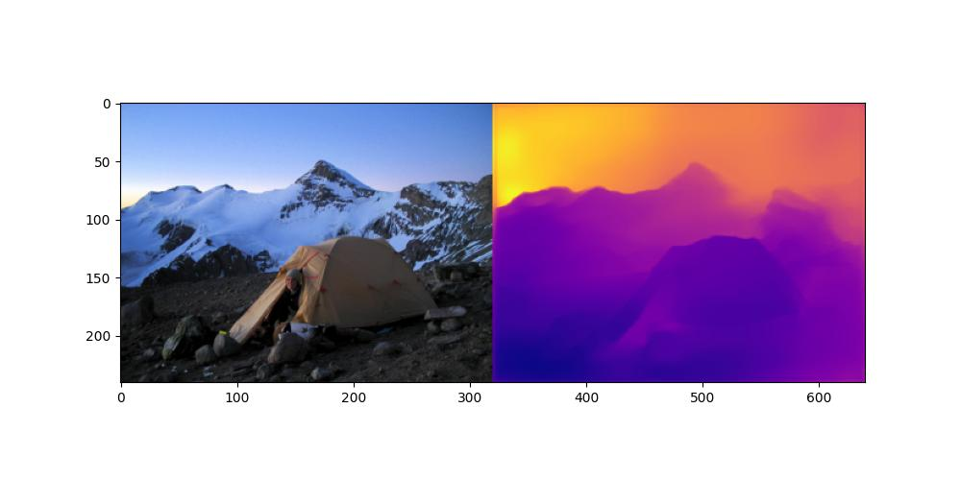
What makes it even more SPECIAL?
In real world, when two sounds are being produced at a time, the intensity with which they are heard varies.
We replicated this phenomenon by using heat maps.
Using heatmaps, we interpret the relative positioning of the entities within the picture and adjust the intensities of the sounds to be played.

Slide 10
Time for a Demo

Slide 11
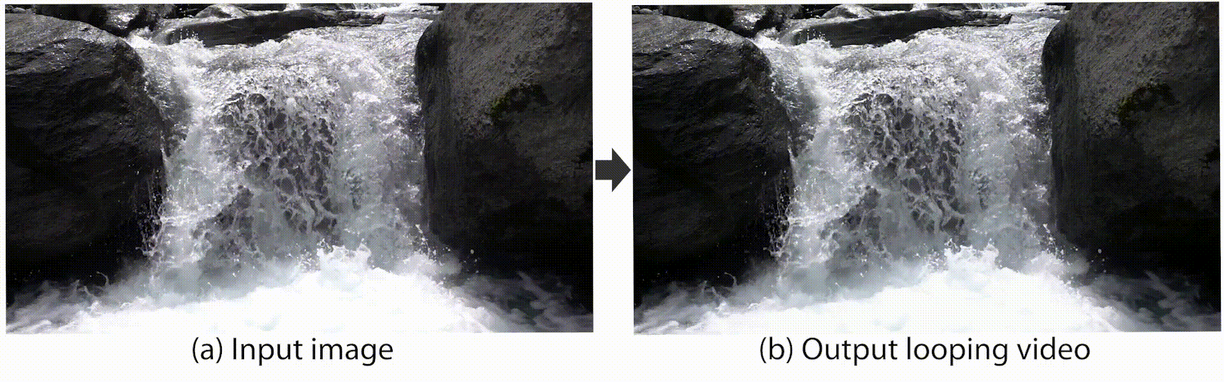
Future Scope
Creating more realistic augmented images with image animation.
Building an app which returns accurate sound map of captured images in real time.

Slide 12
Thank You

